Slide 1
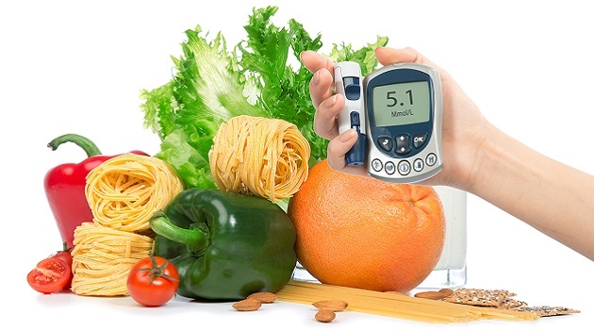
Diabetes and You
Machine Learning Project
Data Dwellers: Geoff Farrell, Jeremy Jackson, Jim Hernandez, Lainie Canfield, Sehajpreet Khanna, Fatima Carrillo
This Photo by Unknown Author is licensed under CC BY-ND
Notes:
Geoff

Slide 2
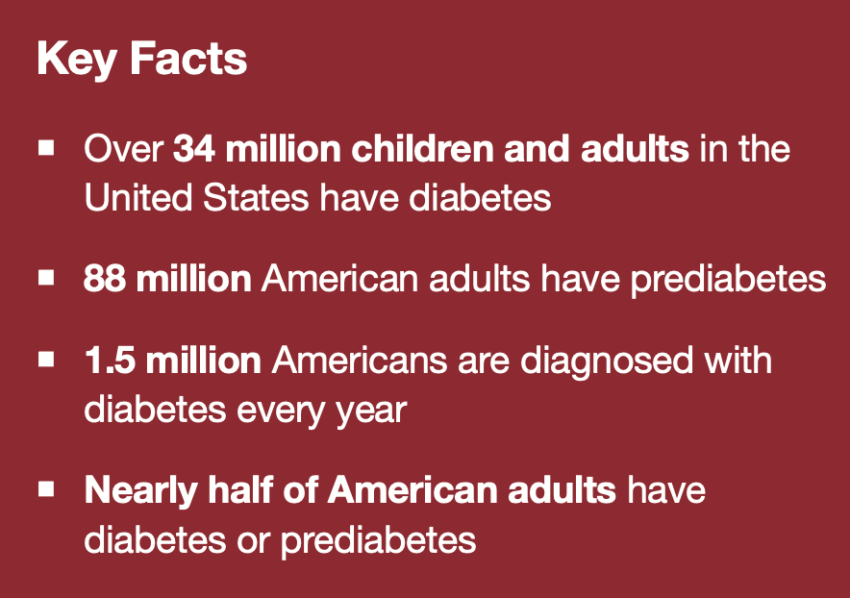
Cost of Diabetes
$327 billion is the total economic burden in 2017 in the U.S. of diagnosed diabetes. This includes $237 billion in direct costs and $90 billion in reduced productivity.
More than 60% of nontraumatic lower-limb amputations occur in people with diabetes
7.3 million Americans have undiagnosed diabetes
89% of adults with diagnosed diabetes are overweight or obese
Diabetes kills more Americans every year than AIDS and breast cancer combined
A person with diagnosed diabetes at age 50 dies, on average, six years earlier than a peer without diabetes
Notes:
Geoff intro

Slide 3
The development of our Machine Learning Model:
Define our objective
Obtain the data
Conduct EDA on our data , utilizing the insight gained from visualization of our data
Through testing and training, decide on which particular model would be the best fit for our data and meet our objective.
Models used for training and Testing: KNN (K Nearest Neighbors), Random Forrest, Decision Tree, Logistic regression
ML library we utilized: Scikit learn
Also used the following libraries/dependencies/modules: Python Pandas, Python Matplotlib – specifically Seaborn, HTML/CSS/Bootstrap, Flask
Utilized flask to create a web application.
Notes:
Geoff

Slide 4
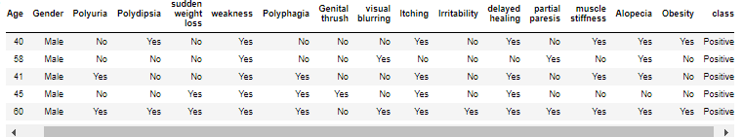
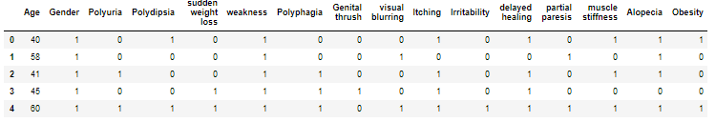
Used pandas for our Dataframes
Example of our data frame converted our “Yes” into 1 and “No” into 0
Notes:
Jim

Slide 5
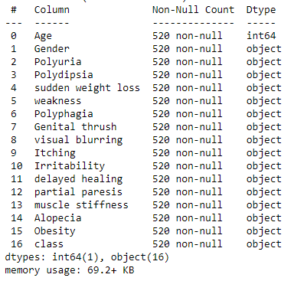
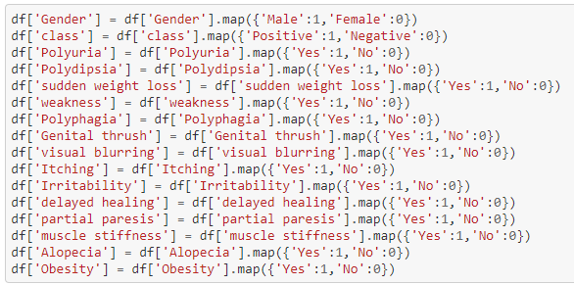
Utilizing the below features
We had to convert our objects into numbers for our model to read: example: “Male” : 1, “Female”: 0
Notes:
Jim
Explanation of features:
Age = Integer
Gender = Yes and No
Polyuria (frequent Urination) = Yes and No
Polydipsia (abnormally great thirst) = Yes and No
Sudden weight loss = Yes and No
Weakness = Yes and No
Polyphagia (extreme hunger) = Yes and No
Genital thrush = Yes and No
Visual blurring = Yes and No
Itching = Yes and No
Irritability = Yes and No
delayed healing = Yes and No
partial paresis (Tingly feeling)= Yes and No
muscle stiffness = Yes and No
Alopecia = Yes and No
Obesity = Yes and No

Slide 6
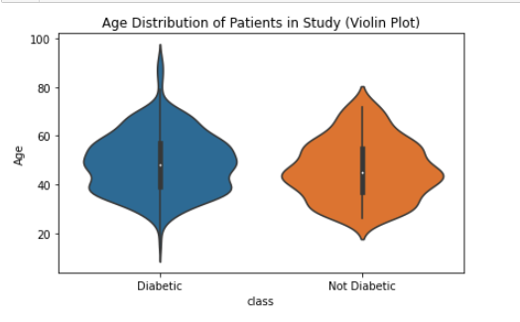
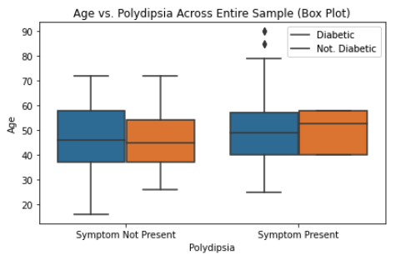
Exploratory Data Analysis We used Matplotlib - Imported Seaborn
Notes:
Sam
Speak on the exploratory Data Analysis
Age also plays a factor in diabetes – you will notice the risk are higher as we age
Age vs Polydipsia (abnormally great thirst) across Entire sample - age again plays a factor in symptoms.

Slide 7
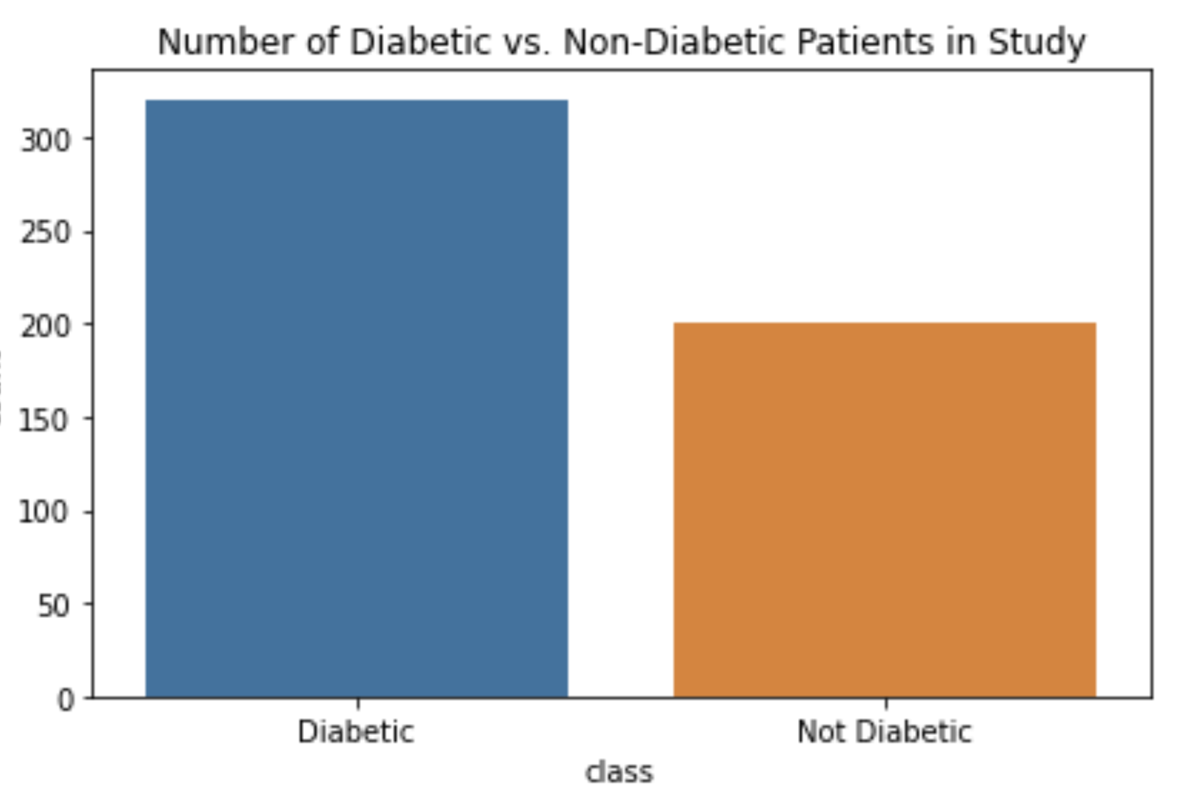
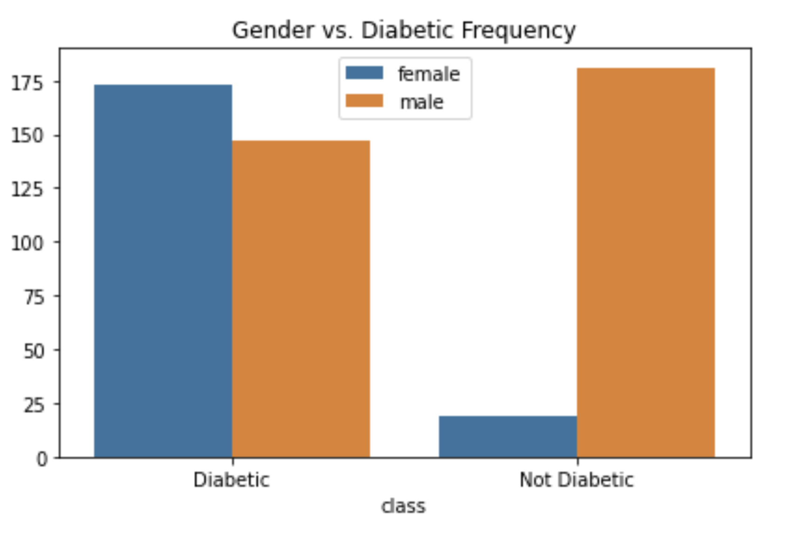
Exploratory Data Analysis We used Matplotlib - Imported Seaborn
Notes:
Sam
Number of diabetics vs nondiabetics patients in the study show over 300 positive diabetics vs 200 nondiabetics
Gender graph shows females are more likely to show positive diabetes.

Slide 8

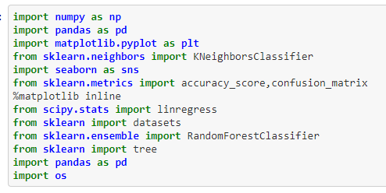
Machine Learning Models
We used Sklearn to explore our data to see what has more of an impact.
We utilized Sklearn for our Model, Fit and Predict
Logistic Regression
Decision Tree Classifier
Random forest
KNN with Grid Search
Notes:
Laine
We used scikit learn to explore out data – we tried the decision tree classifier, Random forest and KNN with added grid search.

Slide 9
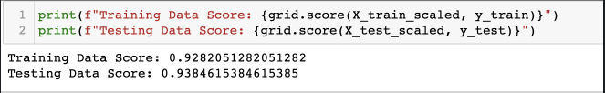
sklearn.linear_model.LogisticRegression
Notes:
Laine
Logistic Regression

Slide 10
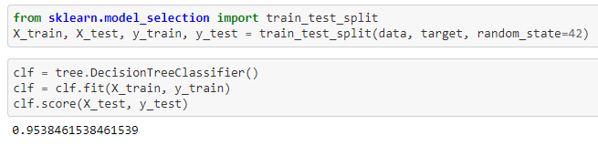
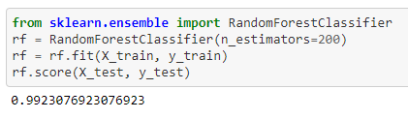
sklearn.tree.DecisionTreeClassifier
sklearn.ensemble.RandomForestClassifier
Notes:
Laine
When we ran our Decision Tree classifier score it came up as 0.95 vs Random Forest score was 0.99

Slide 11
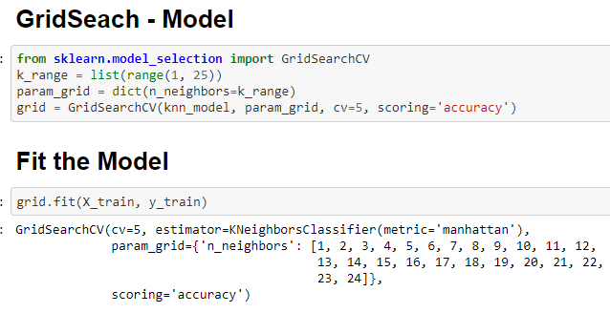
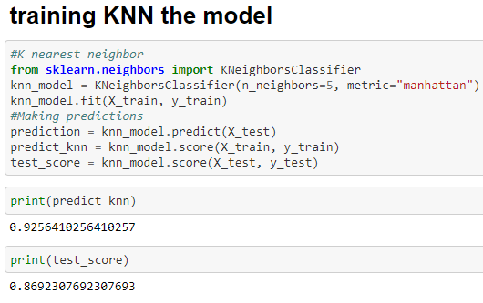
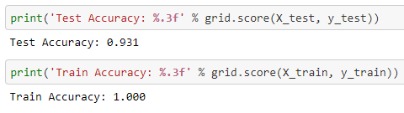
sklearn.neighbors.KNeighborsClassifier
Notes:
Fatima
We ended up using the KNN model to train our webpage and our initial knn prediction our score was .93 w/ a test score of 0.87 We then added a grid search, w/ this we were able to hyper tuned our model and our test accuracy of 0.93 and our train accuracy was 1.00 which is the reason why we used this model KNN w/ the grid search.

Slide 12
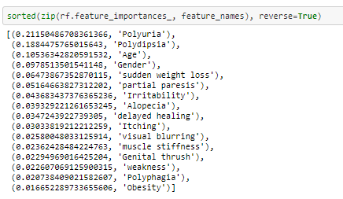
Feature Importance
Notes:
Fatima
We use these features to predict our model, here we were able to pull our feature list from importance to least importance.
Polyuria (frequent Urination)
Polydipsia (abnormally great thirst)
Age
Sudden weight loss
Weakness
Polyphagia (extreme hunger)
Genital thrush
Visual blurring
Itching
Irritability delayed healing
partial paresis (Tingly feeling)
muscle stiffness
Alopecia
Obesity

Slide 13
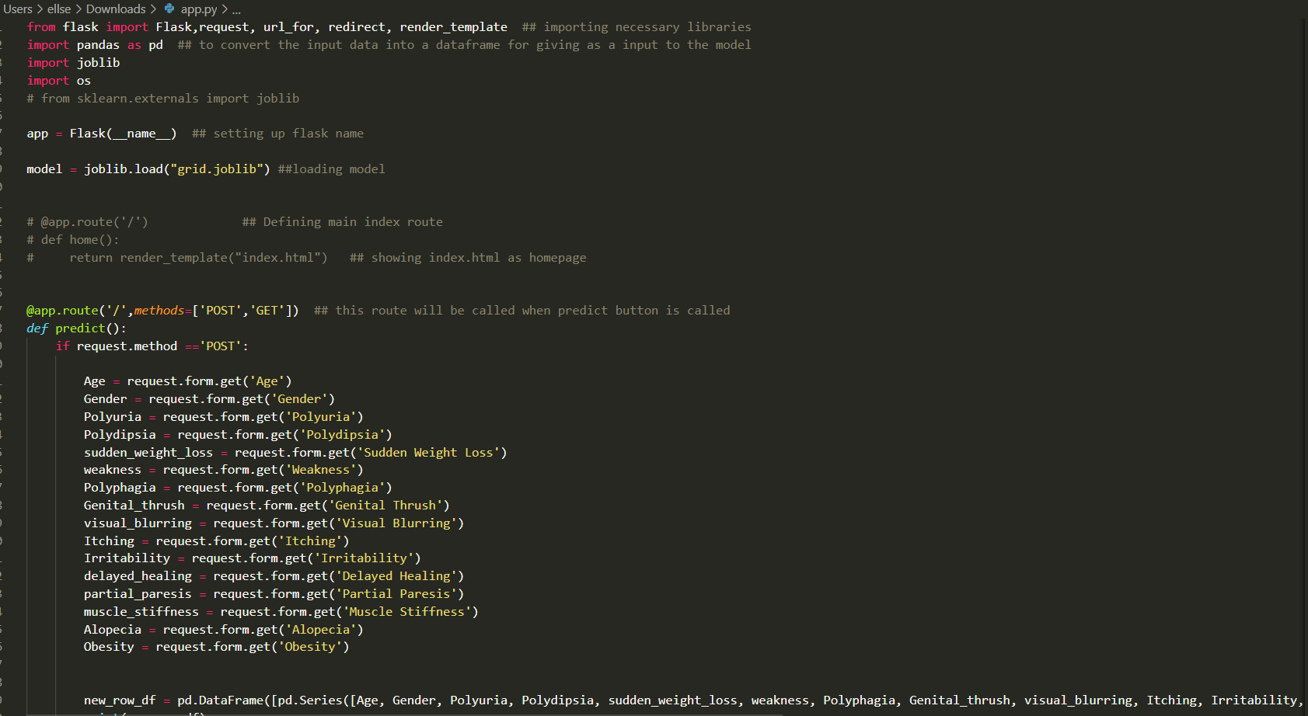
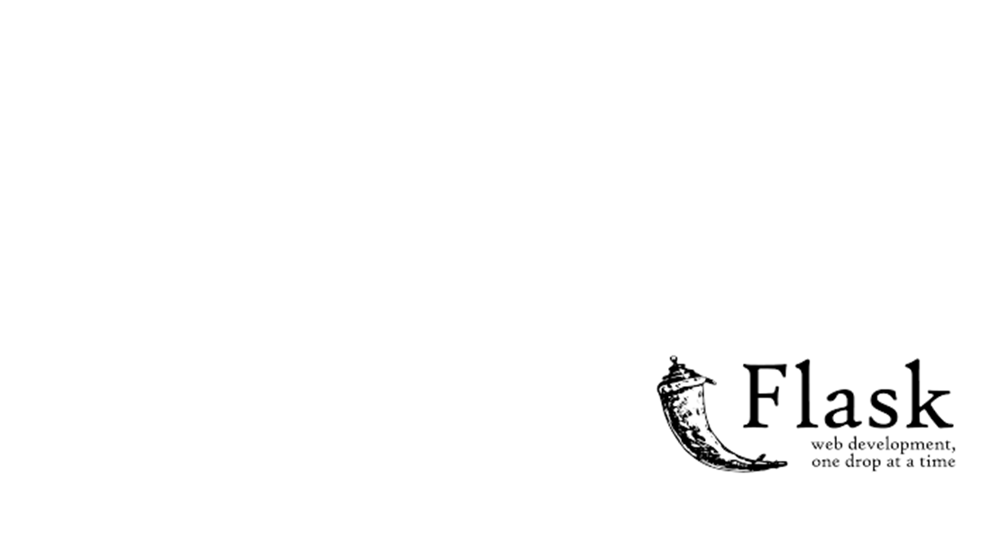
Notes:
Jeremy
Link: https://www.geeksforgeeks.org/retrieving-html-from-data-using-flask/
We used flask to create our app.routes
We used flask to deployed our machine learning model on our app.py. file. And will take the user’s input from HTML form.
Flask will detect user’s input and call the get and post methods

Slide 14
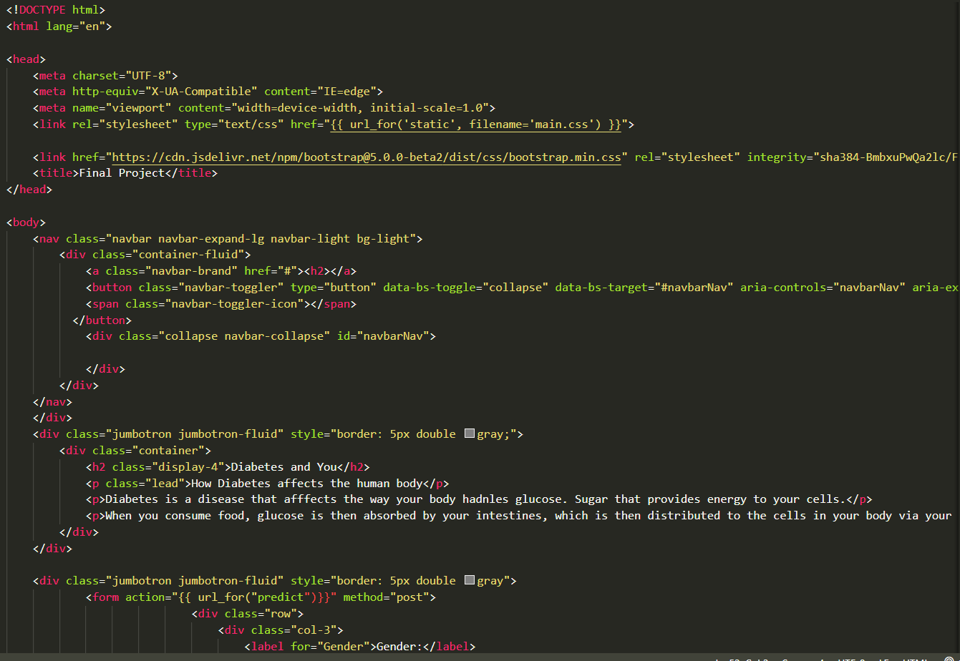
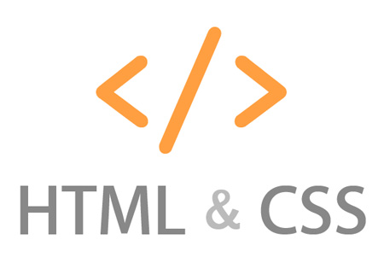
Notes:
Jeremy
The HTML will utilize the user’s input pull the data from flask, which will pull our model and predict our findings.

